Slide 1
Working On Womanhood (WOW)
Shawn Brown, Executive Director
Alithea Casimir, LICSW Program & Partnership Manager
Melinda Vazquez, LSW candidate, Replication Curriculum Specialist

Slide 2
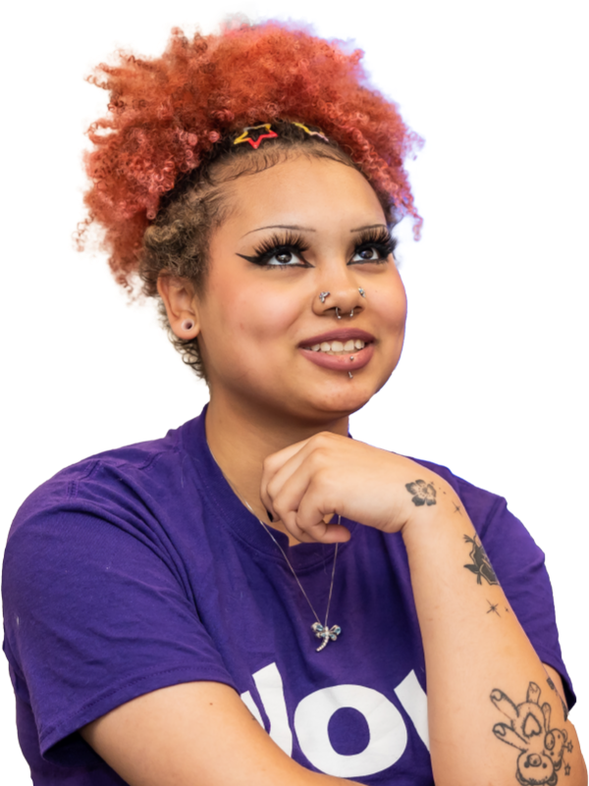

Youth Guidance Mission & Values
Youth Guidance creates and implements school-based programs that enable children to
overcome obstacles, focus on their education and, ultimately, to succeed in school and life.
We believe that no matter what challenges a young person faces, they are more likely to succeed when they have caring adults in their lives.
Core Values
We believe in the potential of all kids
We meet kids where they are
Relationships matter
Our approach is holistic
Being our best is an ongoing process
Notes:
Michelle

Slide 3
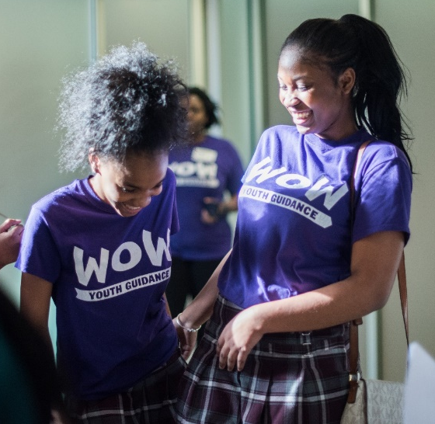

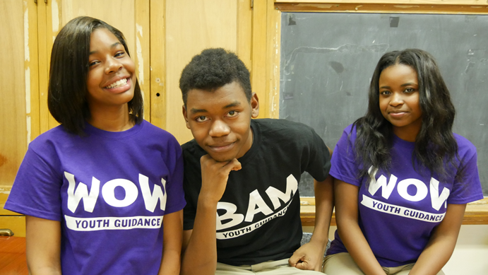
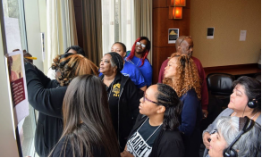
Youth Guidance Programs
Youth Guidance programs reach about 17,000 students across 200 schools around the country.
Counseling &​ Prevention​ | Community &​ After School​ | Career Readiness & Success
Becoming a Man ​ ​ Working On Womanhood ​ STRIVE​ ​ School-based Counseling ​ | Full-Service Community schools​ ​ Parent and Family Engagement ​ ​ Extended Day Enrichment ​ | Project Prepare ​ (In-School)​ ​ Project Prepare Blue (Out-of-School)​ ​ @Work ​ (Post-Secondary Support BAM & WOW)​ ​
Notes:
Michelle

Slide 4


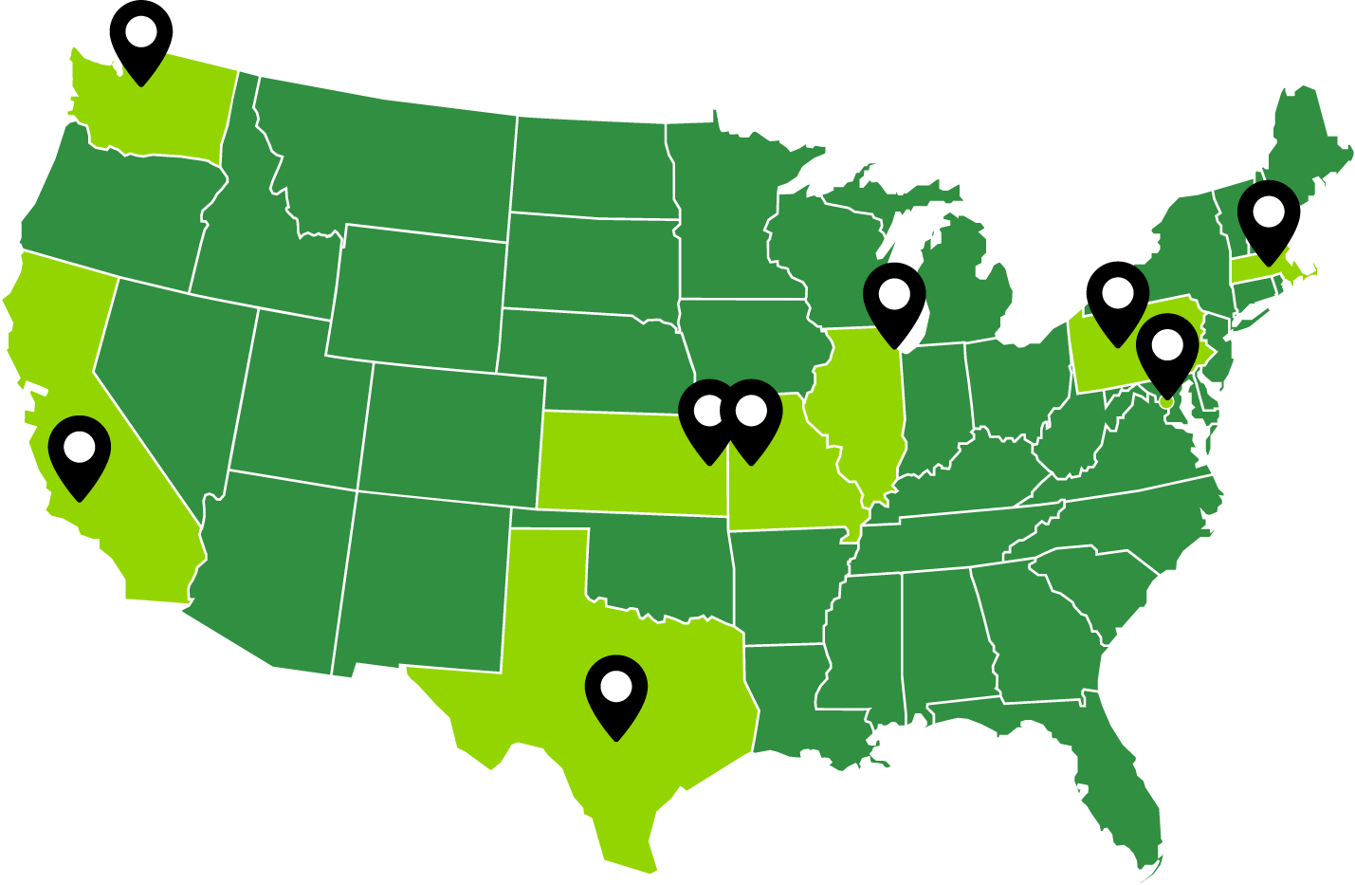
Scaling to meet the need
Boston, MA
Chicago, IL
Waukegan, IL
Dallas, TX
Kansas City, MO and KS
Los Angeles, CA
Greater Pittsburgh, PA
Greater Seattle, WA
Washington, DC
London, England
In 2017, Youth Guidance expanded BAM from Chicago to serve youth in Boston due to a demand by Boston Public Schools and WOW was launched there a few years later. In 2023-24, BAM and WOW now reach 12,000 students across 10 sites.

Slide 5
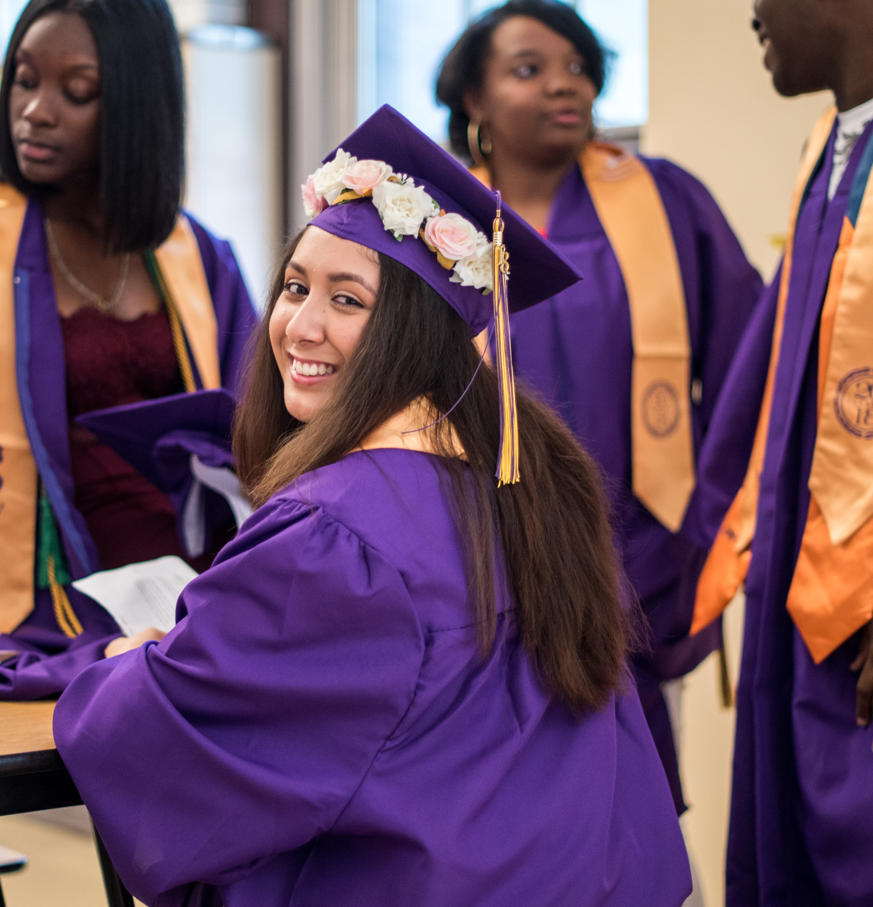

Working on Womanhood (WOW)
WOW is a school‐based group counseling and mentoring program that improves the social‐emotional and behavioral competencies of students in grades 6‐12 who’ve been exposed to traumatic stressors and face social, behavioral, cognitive, or emotional challenges.
WOW GOALS
Increase psychological and social‐emotional well‐being
Improve school engagement and academic attainment
Increase utilization of safe and healthy behaviors

Slide 6
Origins of the WOW program: trauma-informed, school-based counseling model
2011: 1st Launch
6 clinicians serve 200 girls and young women
Formalizing Curriculum
2015, 2017: Formative Evaluation
Community-based participatory research
Evaluation & Program Planning
2018, 2019: Impact Evaluation
Randomized Control Trial
with Urban Lab from UIC
2023: Impact Report
Final impact report published
5
Notes:
Gail

Slide 7

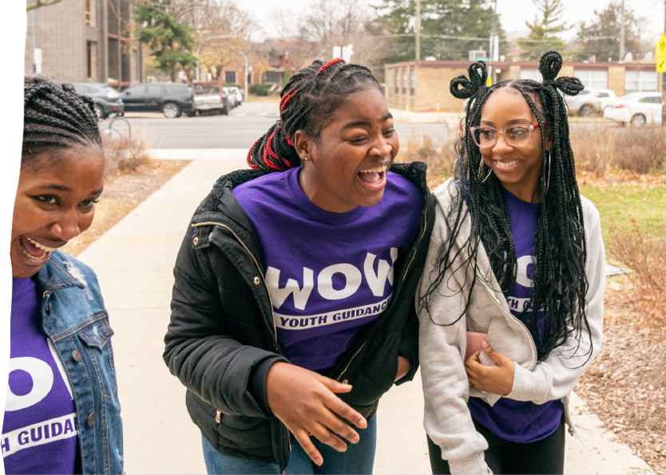
OVERVIEW
WOW was launched in Chicago in 2011, as an innovative response to the urgent need to reach girls and young women of color across under-resourced Chicago communities.
WOW is a two-year school-based curriculum, delivered through 26 weekly group counseling lessons, implemented for 7th-12th grade girls and young women, living with high-risk for exposure to trauma.
WOW Counselors deliver the weekly curriculum in a designated classroom, inside the school, during the school-day, in a WOW room that is considered a safe space – free from stigma and judgement.
WOW group sessions include 10-12 young women and each counselor has a case-load of roughly 55 young women, per-school.

Slide 8
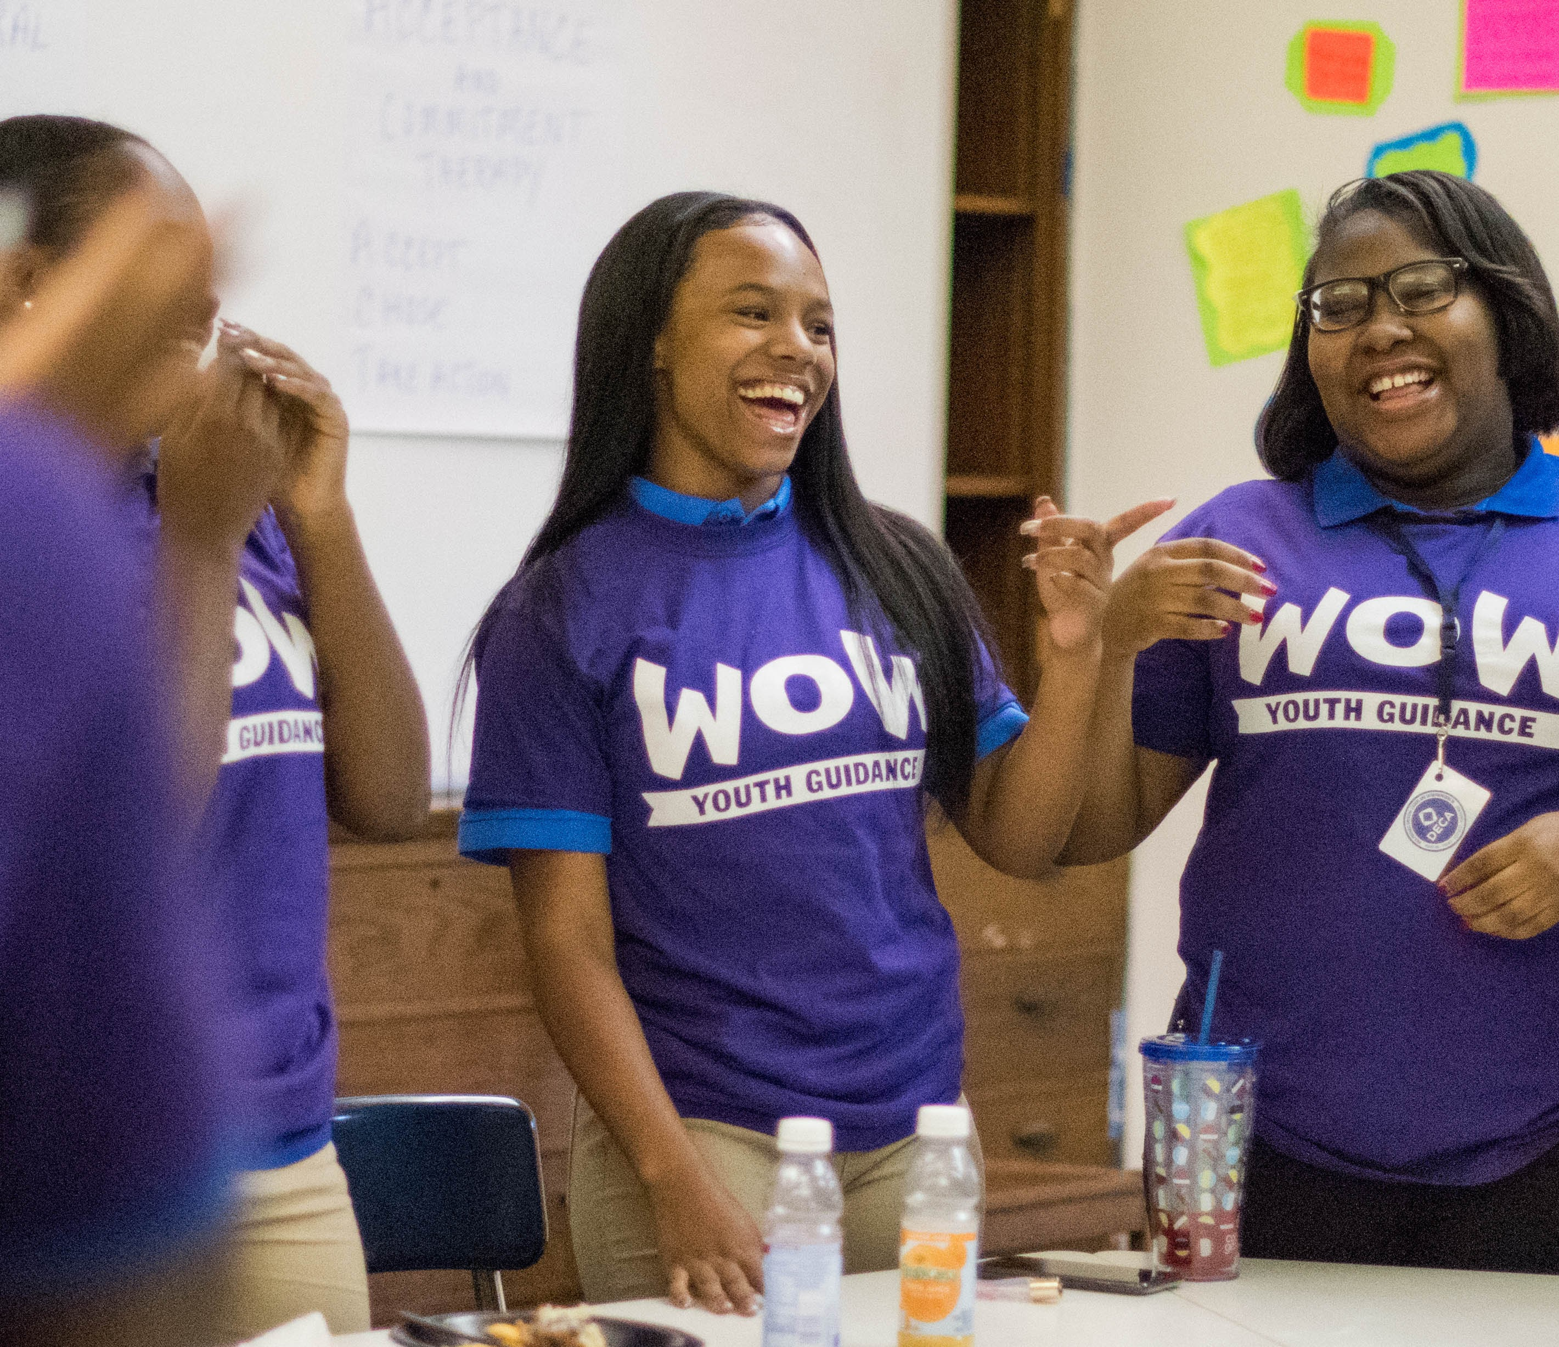

WOW Circles
Learning and growth primarily takes place within the Circle:
Safety and Trust
Authenticity
Positive Relationships
Therapeutic Principles and Clinical Processing
Dynamic activities from WOW curriculum
Social-Emotional Skill Development through the exploration of each program’s core values
15
Notes:
Ngozi

Slide 9
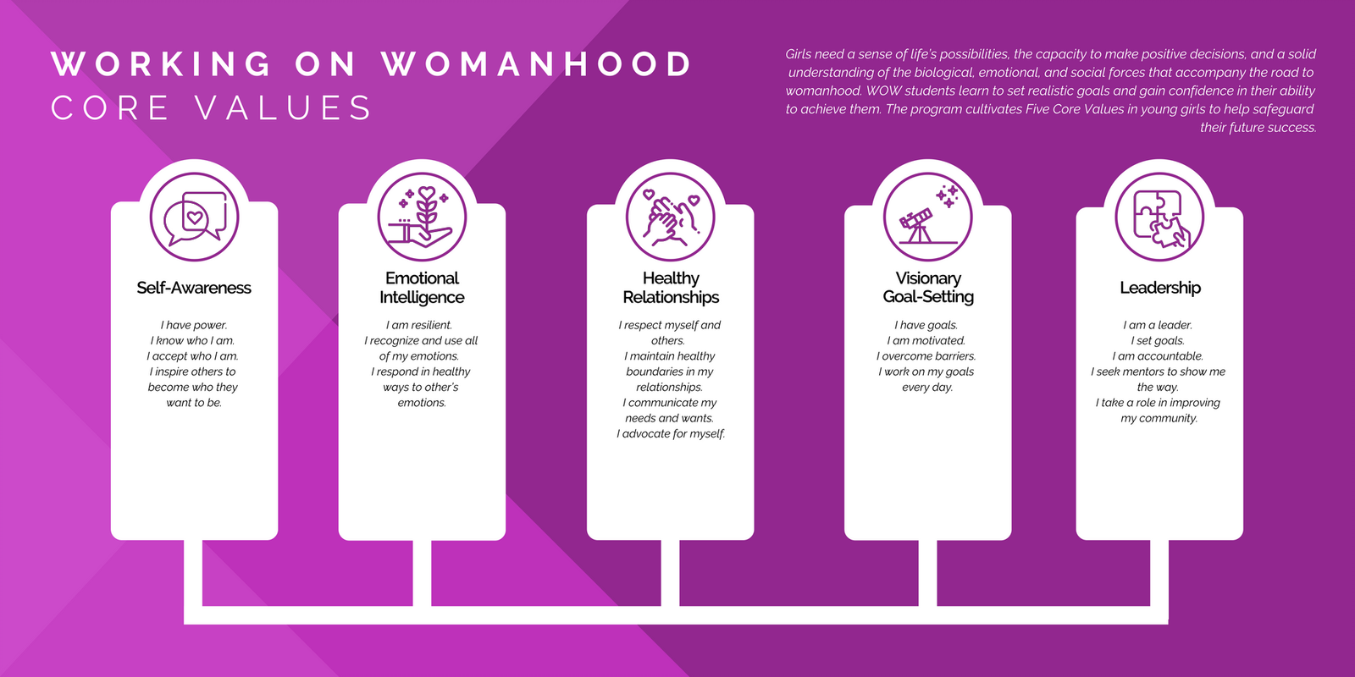
9
Notes:
Gail

Slide 10

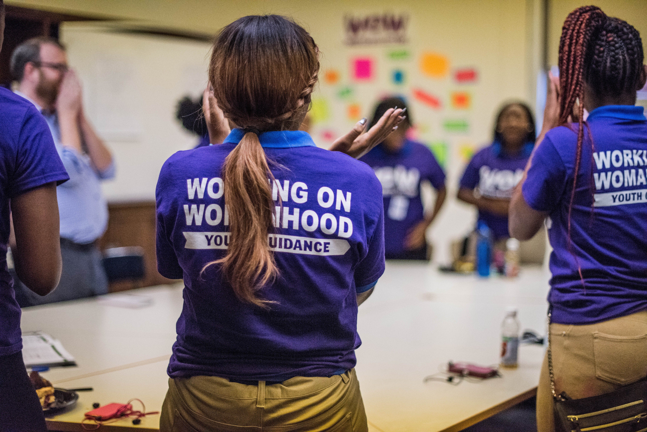
Theoretical Foundations
Cognitive Behavioral Therapy (CBT)
Positive Youth Engagement/Development
Narrative Therapy
Acceptance and Commitment Therapy (ACT)
Trauma-Informed Care
Strength-based Theory
Experiential Learning Theory
13
Notes:
Ngozi

Slide 11

Curriculum Major Themes
Values
Culture
Coping Skills
Relationships
10
Notes:
Ngozi
Values-identifying values and making decisions and goals based on those values
Culture-creating a sense of belonging to a community
Coping Skills-helping to develop a coping tool kit to manage what life throws at them
Relationships-being prepared for all of the different relationships in life

Slide 12
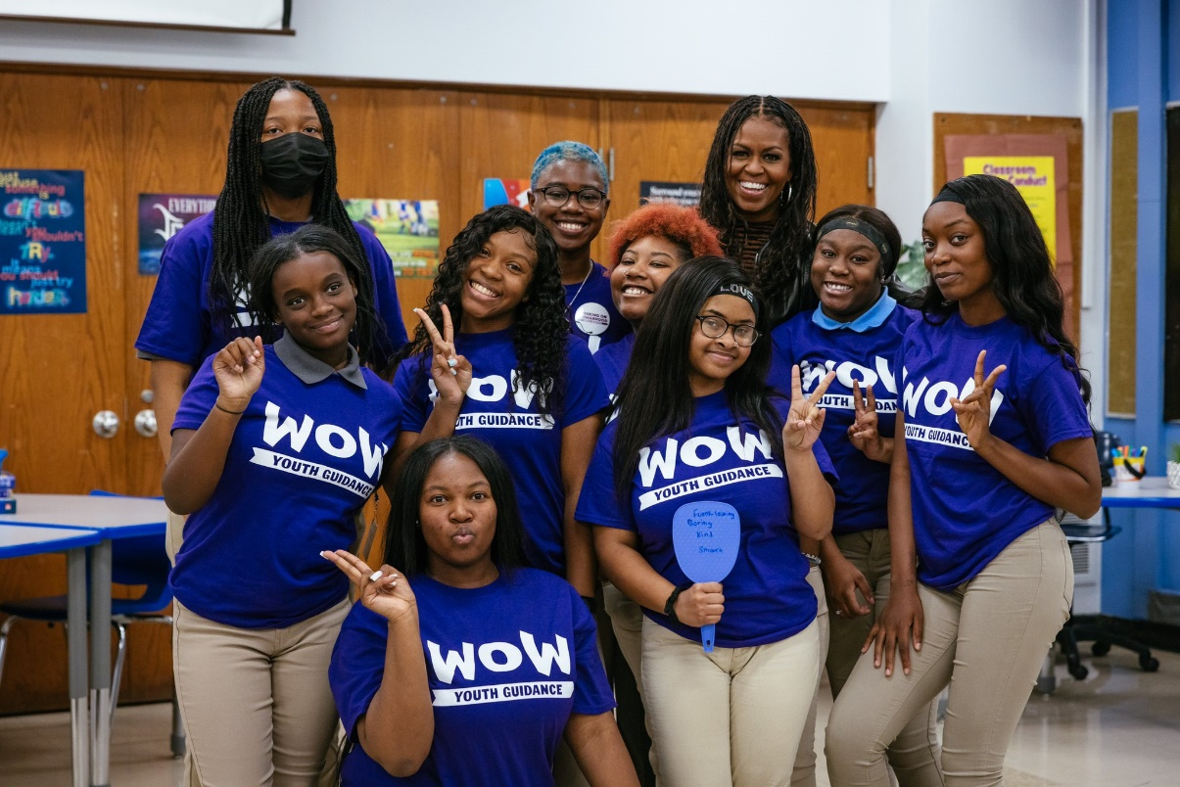
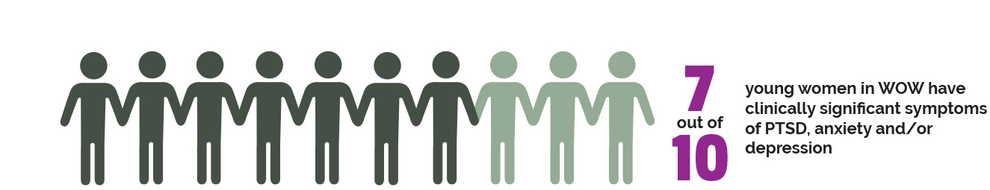

TARGET POPULATION
WOW Participants: Referrals are made to WOW by teachers, school administrators, parents, self, peers and clinicians
Risk Factors: Trauma Exposure
    physical and verbal abuse
    low self-esteem
    suicidal thoughts
    depression
    hopelessness
    feeling alone
    community violence
We believe in the potential of every young woman.

Slide 13
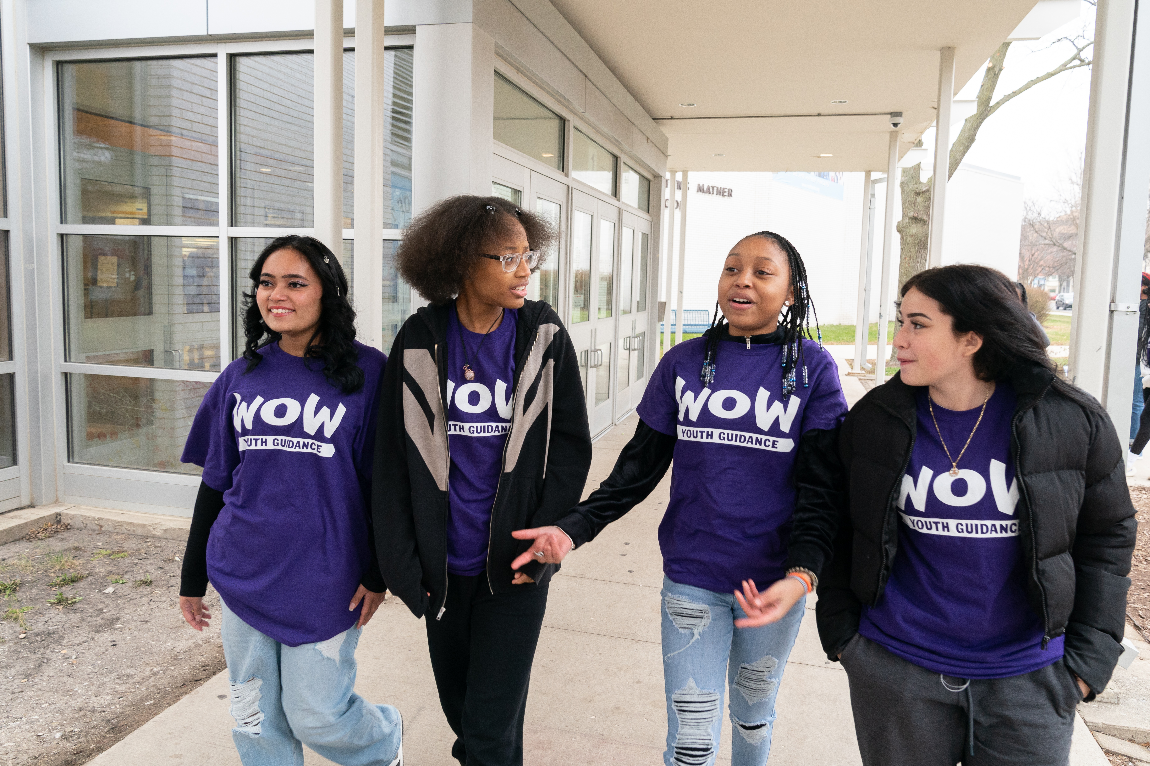
WOW Counselors & Training
Counselor Qualifications
MSW or Master’s in Counseling
(License Preferred)
Group Counseling Experience
Youth Engagement Experience
Openness to Self-Examination & Modeling WOW Skills & Values - "The Parallel Process"
Training & Coaching through the WOW Training Academy (WTA)
Theoretical & Clinical Foundations
Curriculum Training
Technical Skills Training
Site-Based Coaching & Conceptual Feedback

Slide 14
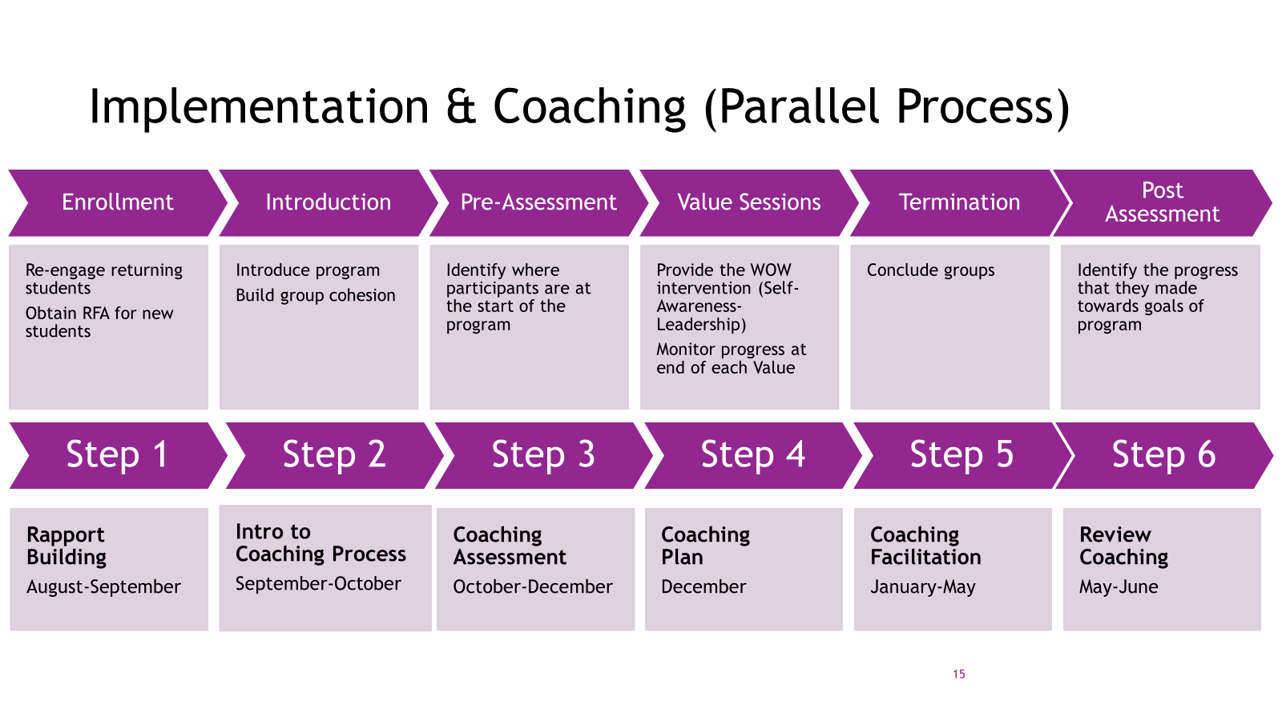

Program Components
Brief Encounters
Crisis Management
Targeted Individual Counseling
Service Learning
Field Trips/Cultural Experiences
Family Engagement and Supports
Recognition Banquet
Post-Secondary Support
Group Counseling/WOW Curriculum
My Vision, My Journey
16
Notes:
Ngozi
So, what are the ingredients of WOW.
Brief Encounters-15 minutes or less time spent reinforcing the learning by just being present in during the school day.
Crisis Management-providing support through emergent things that pop up like SASS calls, advocacy during potential suspensions
Recognition Banquet-provide an opportunity to celebrate the hardwork of all of the WOW girls
Post-Secondary-helping the girls develop a plan for life after high school, giving them tools to navigate the new challenges they will face on this leg of the journey

Slide 15
WOW External Research
WOW decreases girls’ PTSD, depression, and anxiety
22%
38%
14%
10%
PTSD Severity
Scores
Moderate Trauma-Related
Distress
Depression
Anxiety
Monica P. Bhatt et al. ,Randomized evaluation of a school‐based, trauma‐informed group intervention for young women in Chicago.Sci Adv.9,eabq2077(2023).DOI:10.1126/sciadv.abq2077

Slide 16
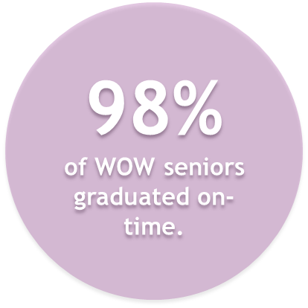
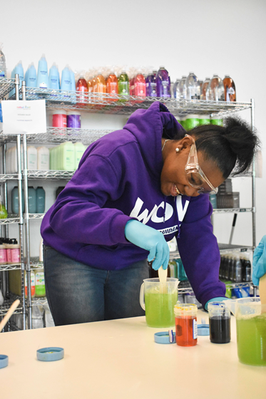
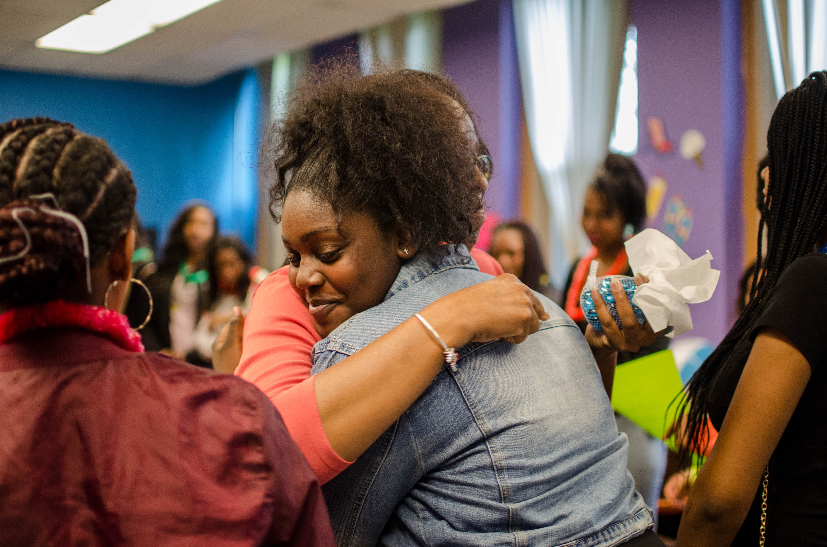
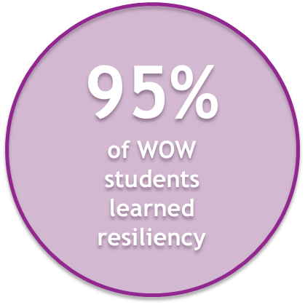
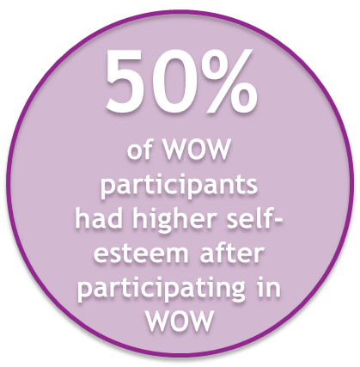
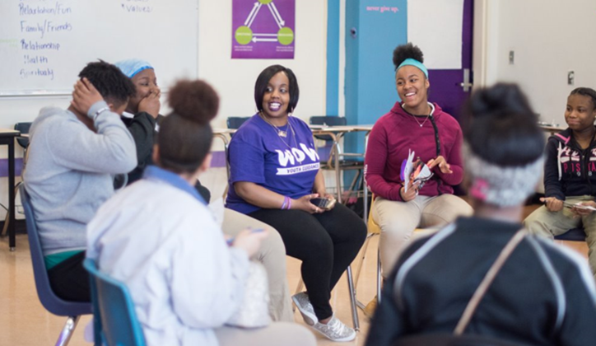

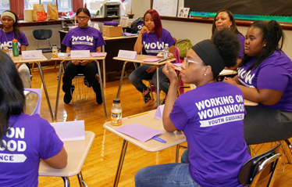
Mattering Matters
97%
of WOW students would recommend WOW to a friend
14
Notes:
Gail

Slide 17
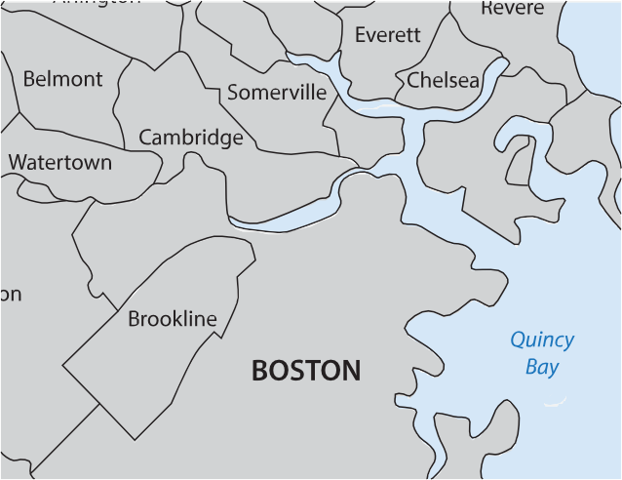
WOW in Boston
WOW launched in Boston in 2021 and operates on 5 campuses across 3 school districts
WOW enrolls 250 scholars annually across Boston, Cambridge, and Somerville Public Schools
  94% of WOW scholars identify as individuals of color
  85% of WOW scholars are low-income
Baseline Data from SY 2022-23
At the time of enrollment:
65% of WOW scholars were experiencing clinical social and/or generalized anxiety
54% of WOW scholars were experiencing clinical Post-Traumatic Stress Disorder (PTSD)
50% of WOW scholars were experiencing clinical depression

Slide 18
WOW Results in Boston
Among WOW scholars experiencing clinical symptoms at enrollment:
69%
experienced a reduction in PTSD symptoms
67%
experienced a reduction in depression symptoms
63%
experienced a reduction in generalized and/or social anxiety symptoms
52%
experienced higher self-esteem after participating in WOW

Slide 19
WOW Results in Boston
WOW scholars experience greater school engagement and academic attainment:
67% of WOW scholars either maintained a high school attendance rate or improved their school attendance compared to the previous year.
96% of WOW scholars were promoted to the next grade level.
94% of WOW scholars reported that the program helped them identify ways to improve their school performance.
WOW scholars established positive relationships with their WOW Counselor
100% of WOW scholars report that they believe their WOW Counselor cares about them
98% of WOW scholars report that they trust their WOW Counselor
98% of WOW scholars report that their relationship with their WOW Counselor is important to them

Slide 20
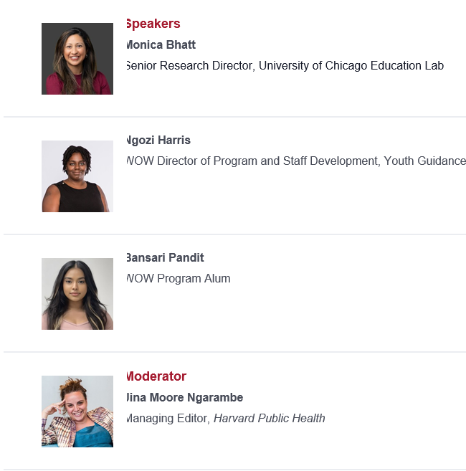
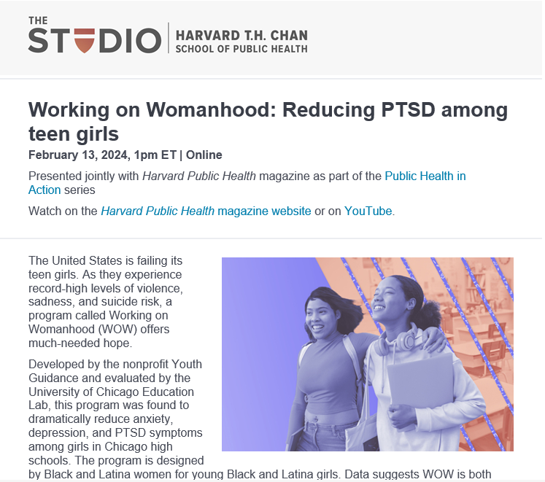
WOW featured in Harvard Public Health magazine
Watch on the Harvard Public Health magazine website or on YouTube.
Notes:
https://www.youtube.com/watch?v=wg0hqeSEwWk

Slide 21
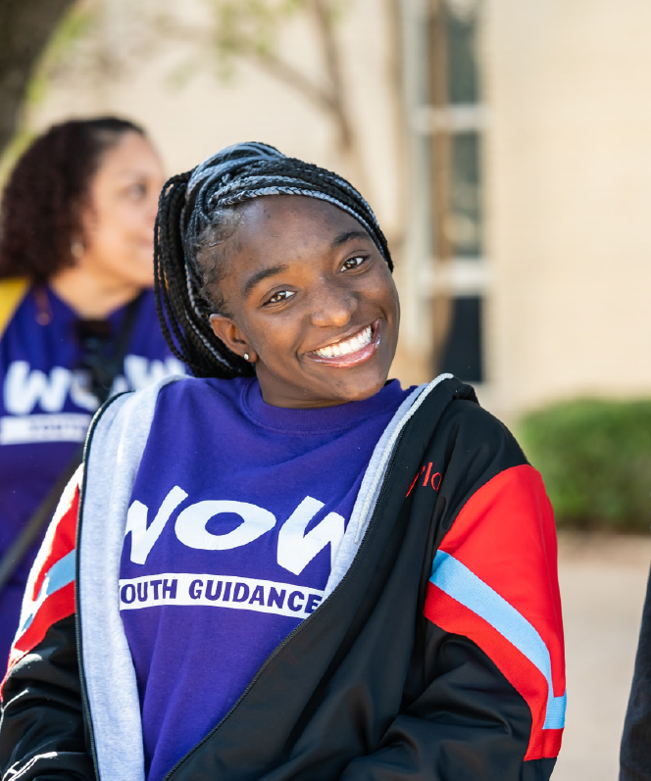

HOW SCHOOLS LOOK DIFFERENT
I joined WOW to better myself. I joined to be a role model to my family. I never would have guessed that I would have joined a circle of friends – a sisterhood – who would make us the best we can be.”
-WOW STUDENT
21

Slide 22
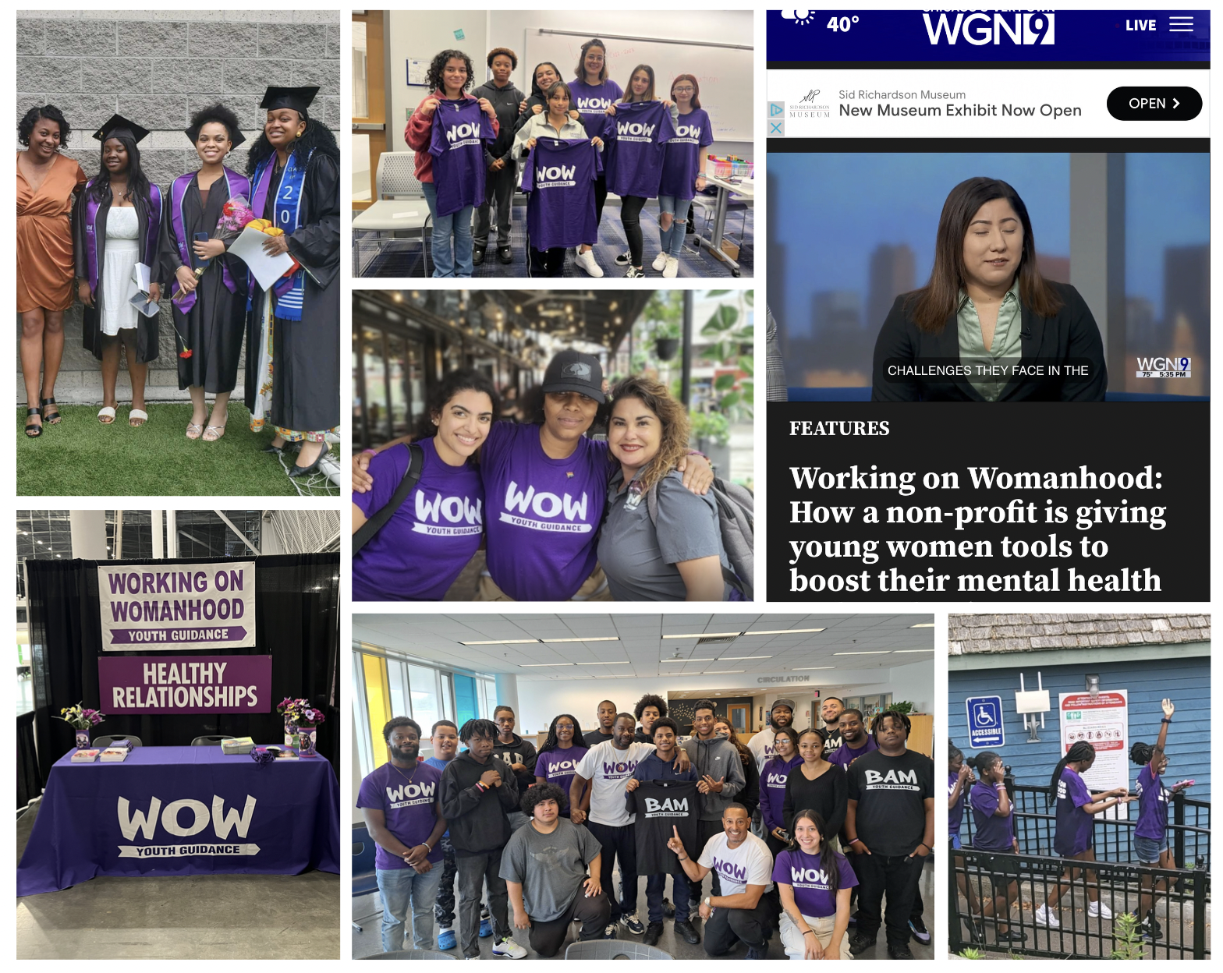


Boston
Notes:
Gail

Slide 23
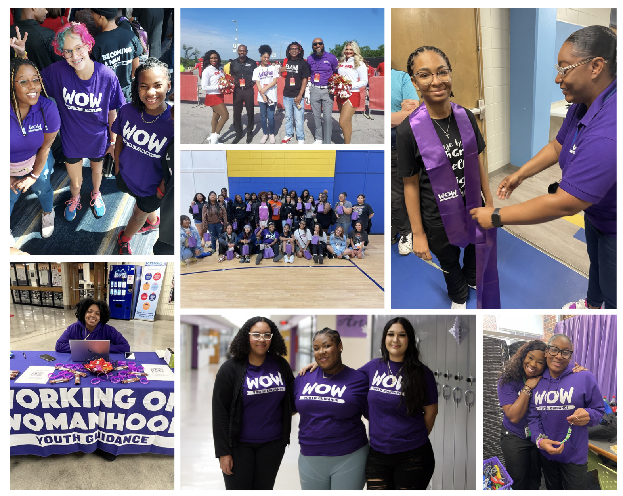
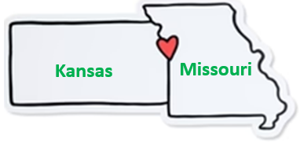



Kansas City
FY24 Theme: TOGETHER
Individually we are strong…TOGETHER we are powerful!
TOGETHER we serve…
….2 States
….3 School Districts
….6 Schools
….over 330 WOW students
Notes:
Introductions of New Advisory Council & Staff Members that are present

Slide 24
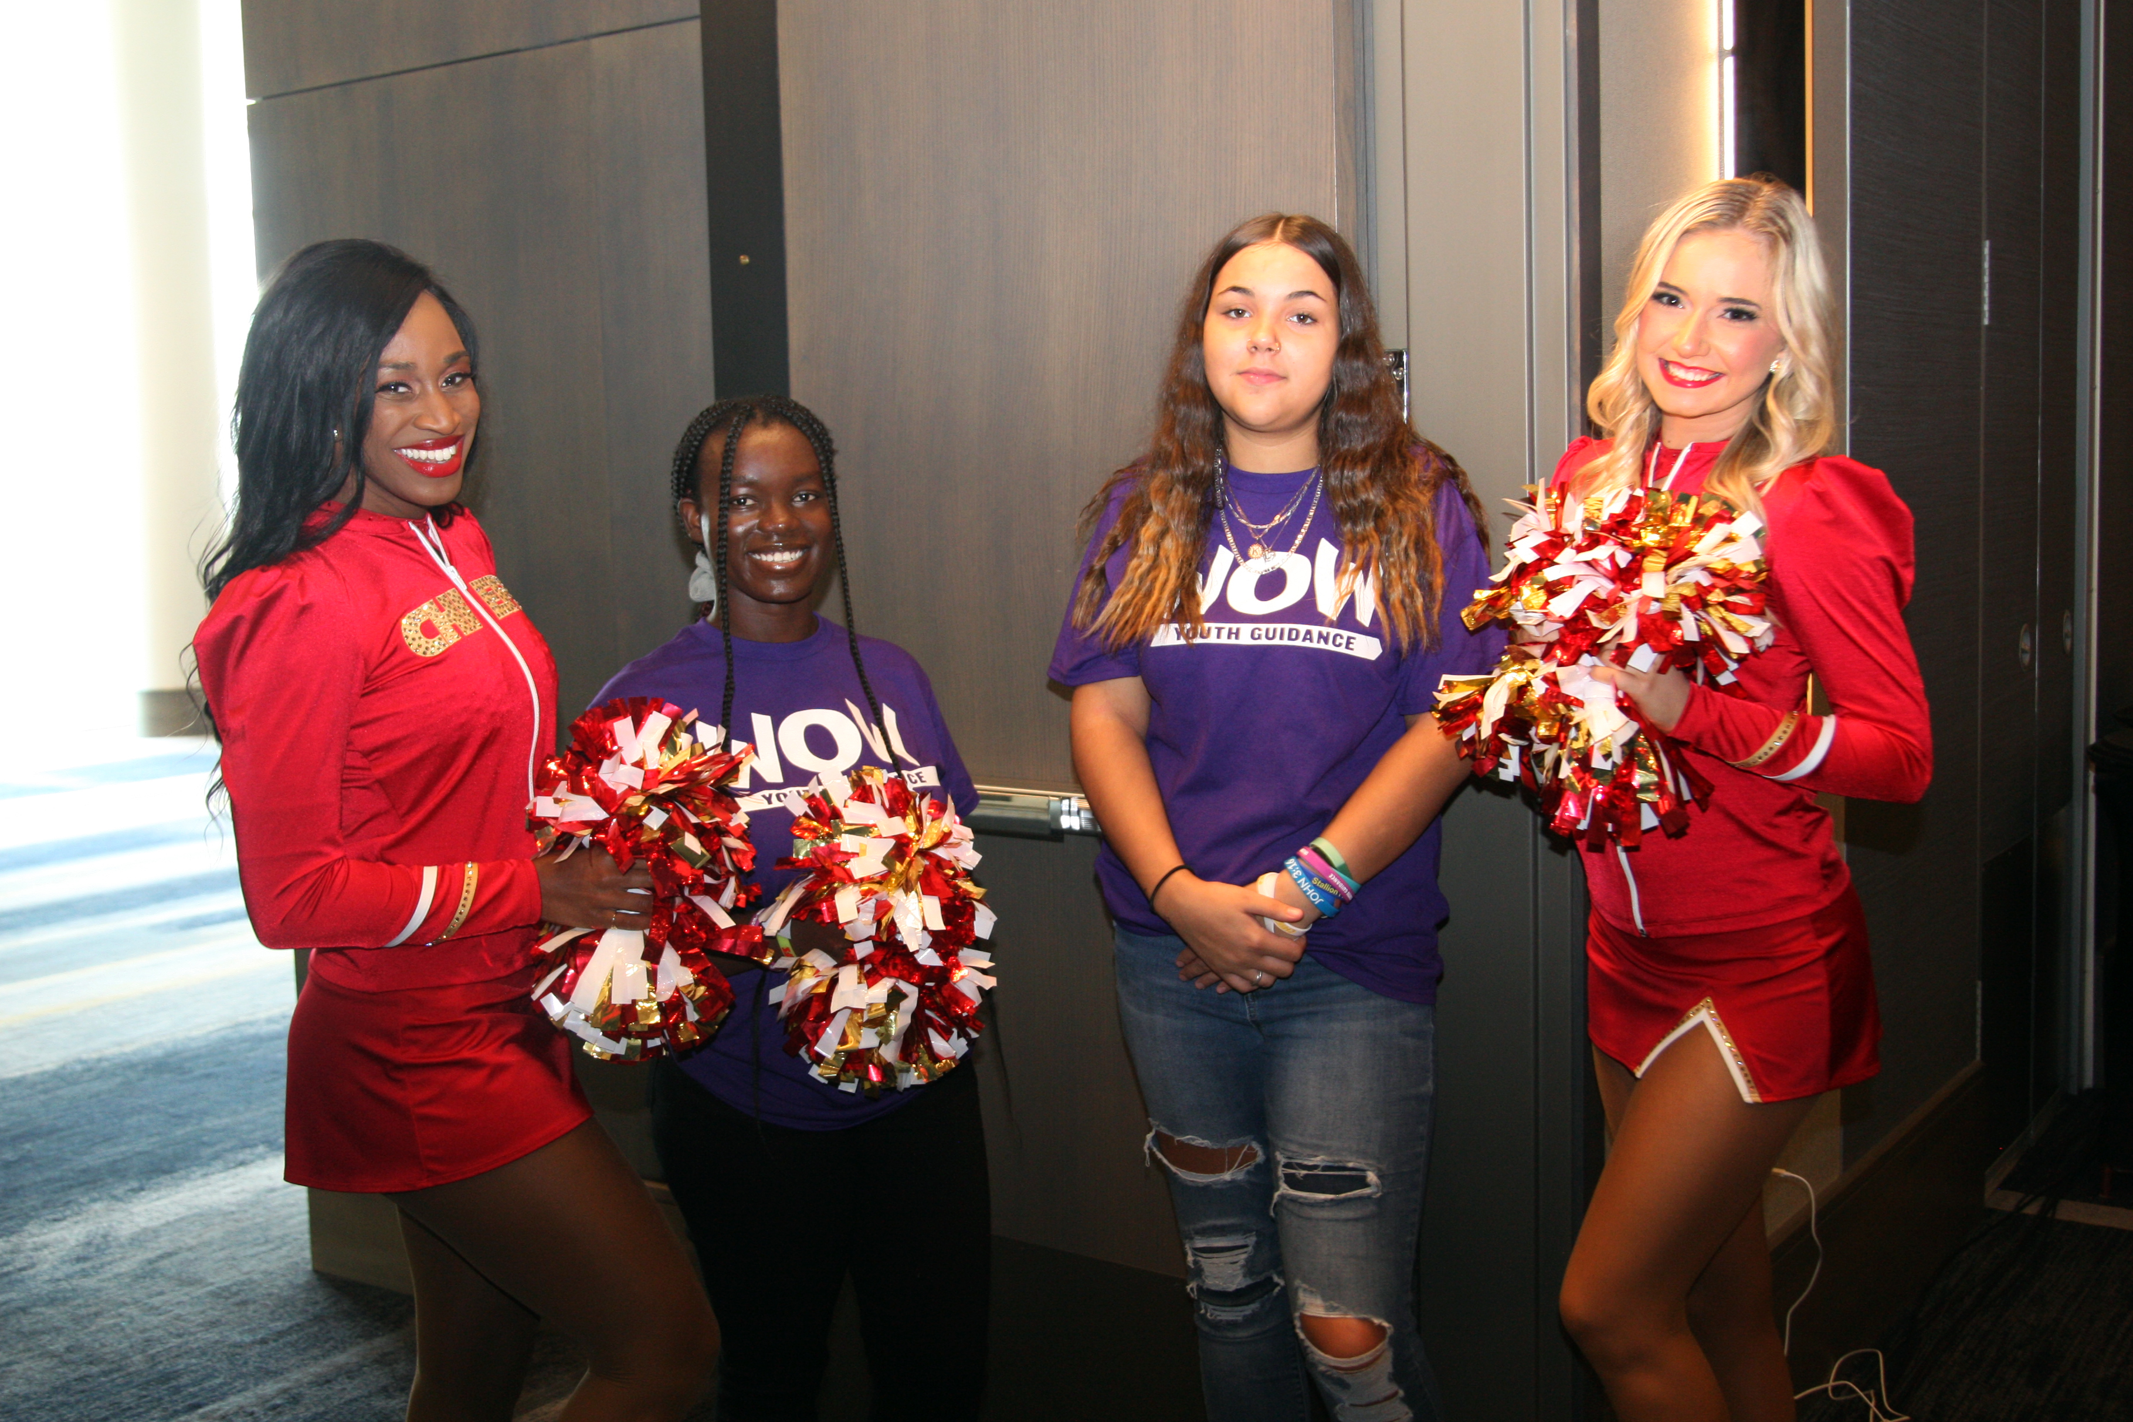
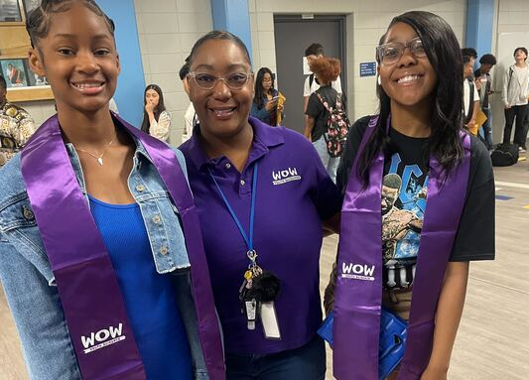
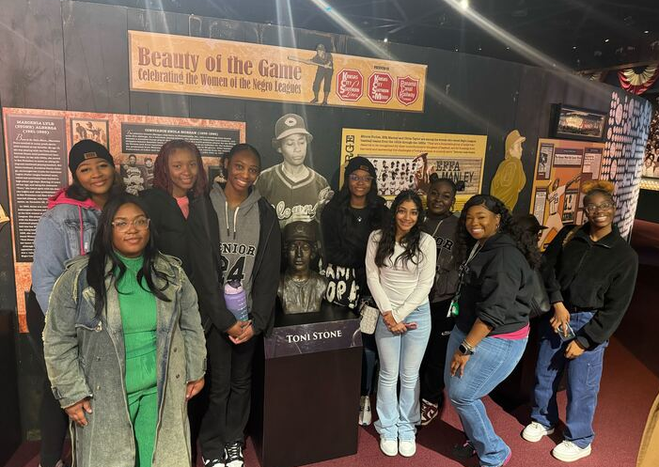
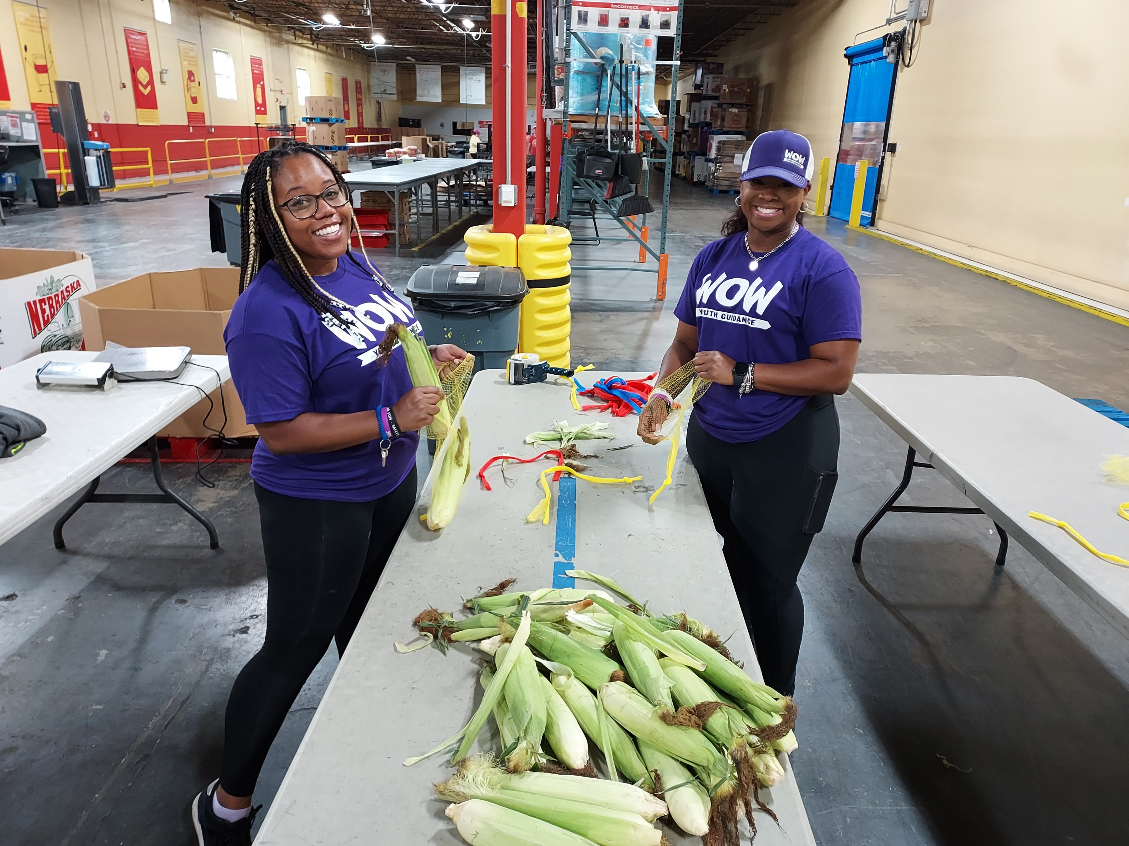
WOW in the Community
Kansas City Chiefs Kickoff Luncheon
8th Grade Recognition ceremony
Negro League's Baseball Museum
Community Service – Harvesters Food Bank

Slide 25
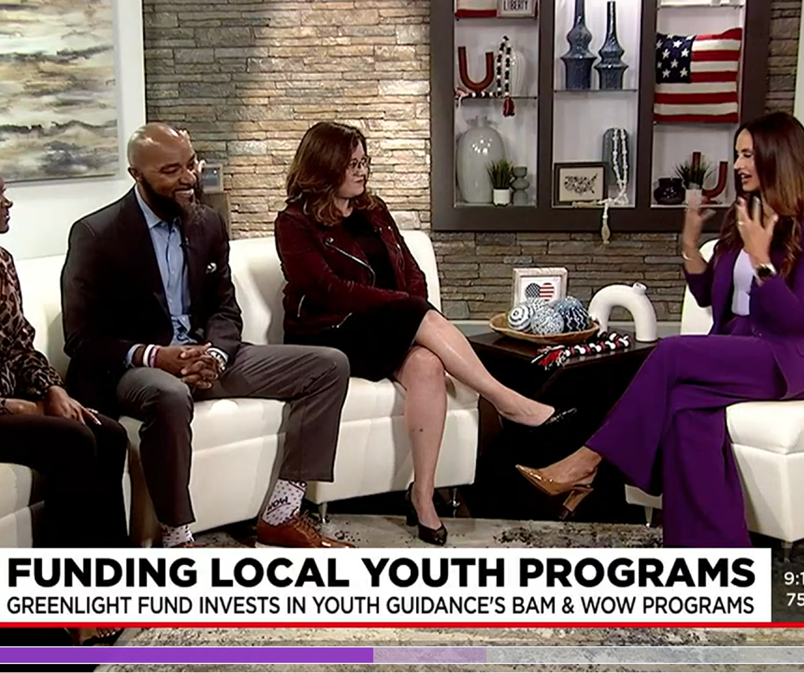
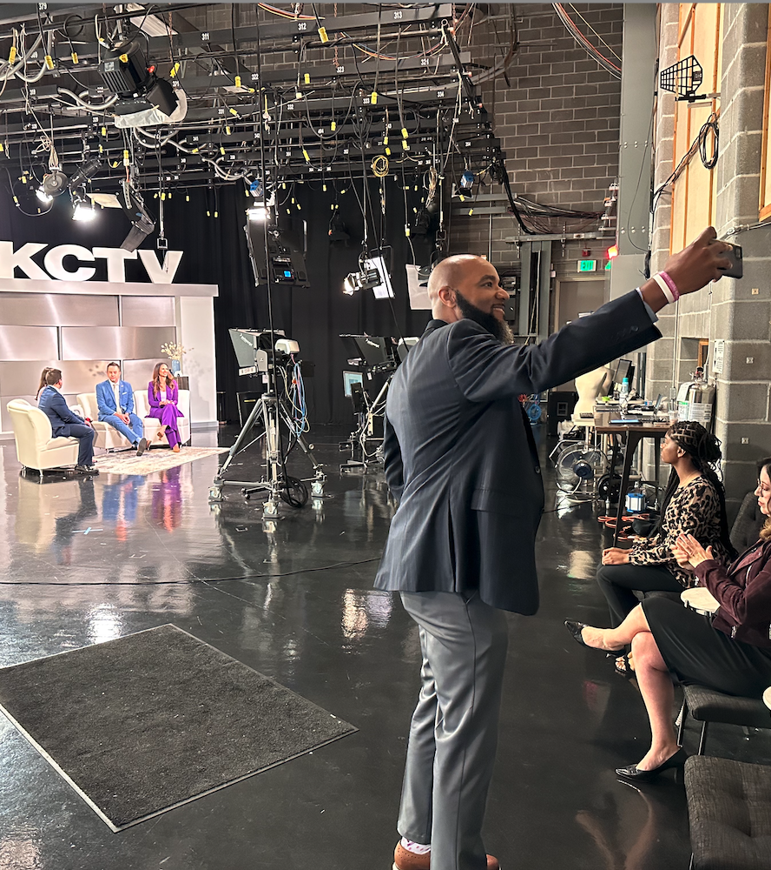
Kansas City Glows
GreenLight Fund and Youth Guidance WOW Kansas City Recognized by KCTV5
Notes:
Introductions of New Advisory Council & Staff Members that are present

Slide 26
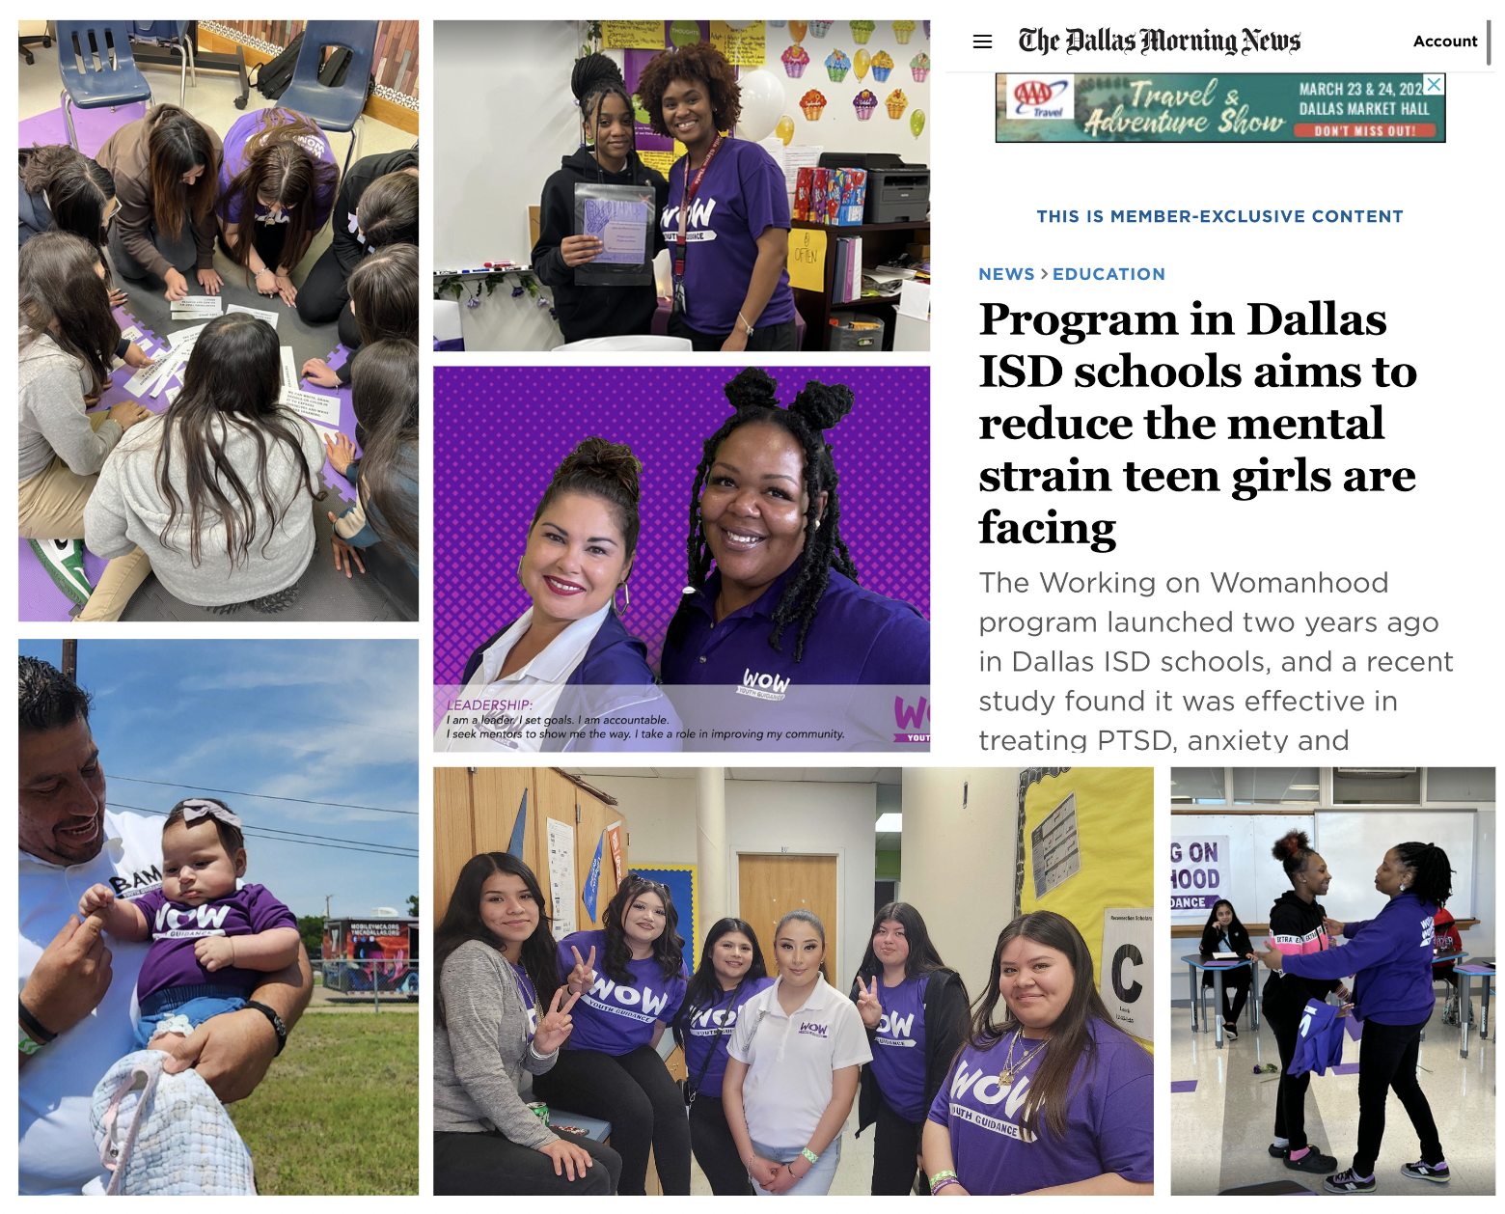
Youth Guidance Dallas
Notes:
Gail

Slide 27
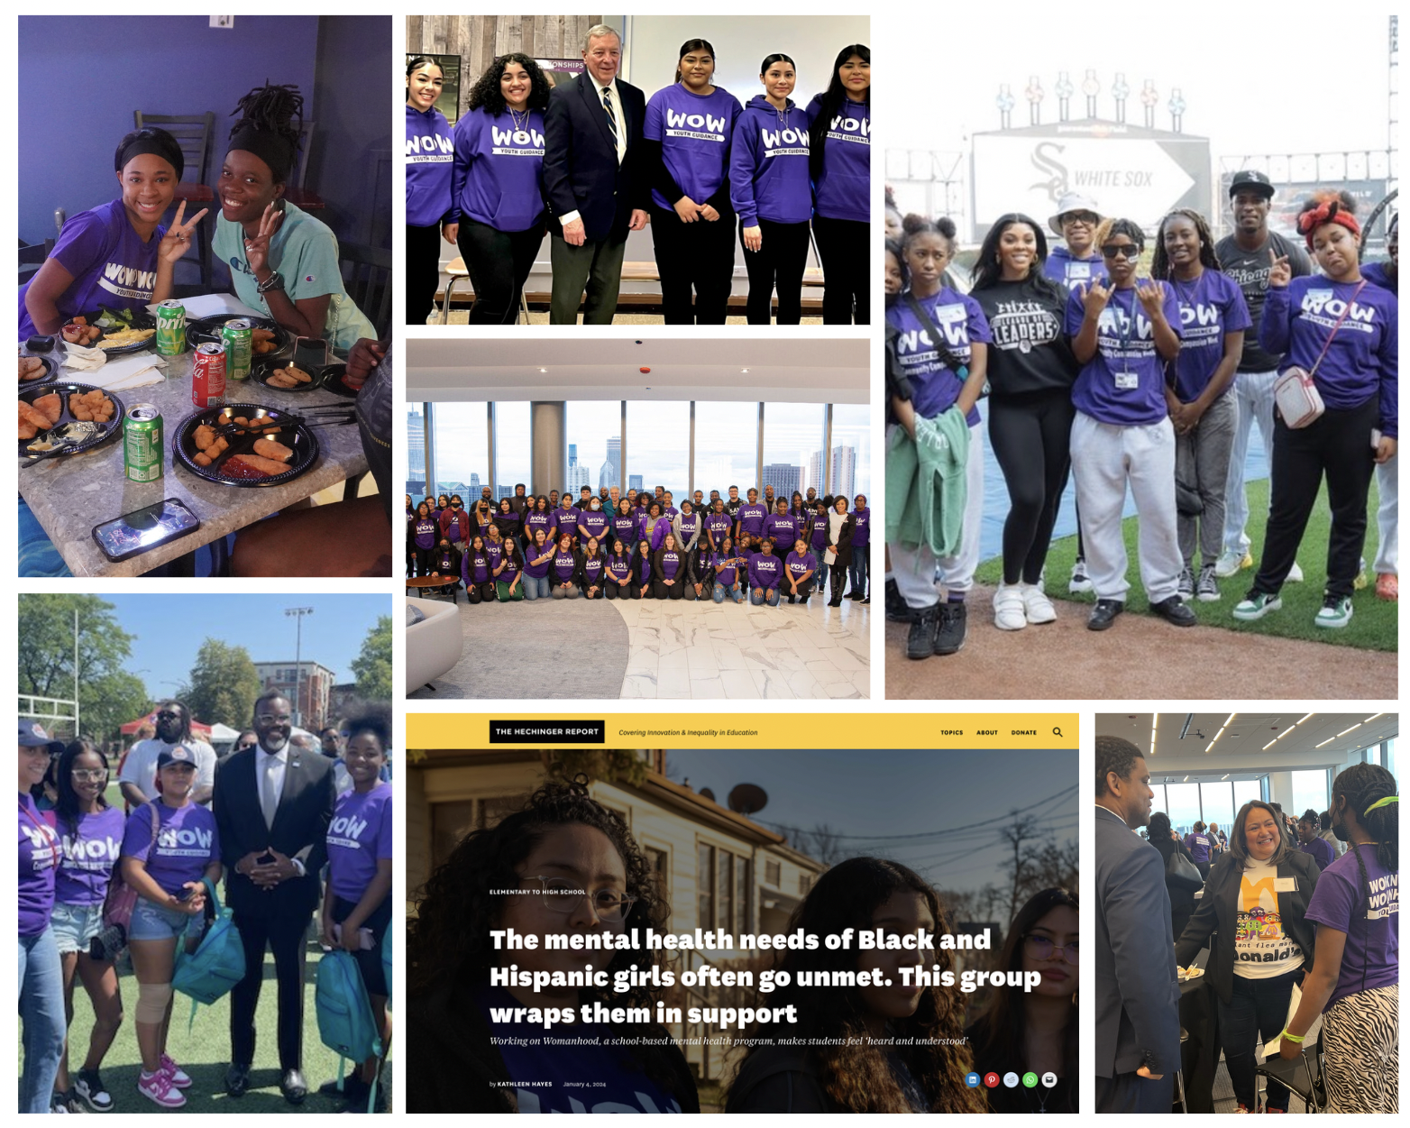
Youth Guidance Chicago
Notes:
Gail

Slide 28
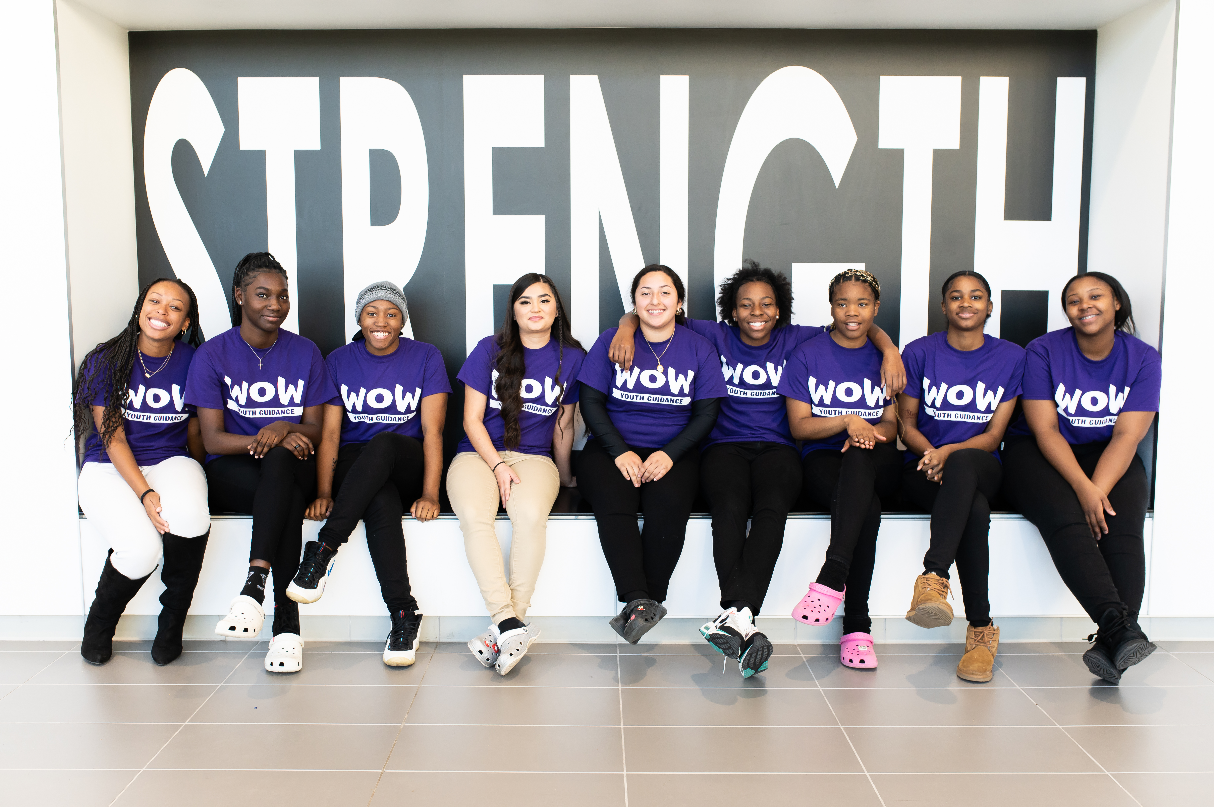
For additional information about Youth Guidance programs:
Shawn Brown
Executive Director, Youth Guidance Boston
Shbrown@youth-guidance.org

Slide 30
A serious natural disaster
Being robbed by threat, force, or weapon
Seeing someone attacked, stabbed, shot at, or hurt badly
A serious accident or injury
Someone close to you dying suddenly or violently
Seeing someone in the community get slapped, punched, or beat up
Being around war
A stressful or scary medical procedure
Seeing someone in your family get slapped, punched, or beat up
Being attacked, stabbed, shot at, or hurt badly
Notes:
Imagine you have experienced any of these things – how could you be expected to focus on this presentation knowing this could happen to you when you leave this room. This is what young women experience when having to sit through class school. What do parents living elsewhere do? Imagine your child has experienced this – what would you do?
Most of the time, it would mean one-on-one therapy. How do we offer similar supports on a broad scale for women living in these communities?

Slide 31
On average, young women attending the high schools
in our study have experienced
of these adverse events.*
at least two
*Due to mandatory reporting requirements, our research team could NOT account for experiences of:
1) being hit or ‘beat up’ by a non-family member, 2) being hit or ‘beat up’ by a family member, 3) sexual abuse, or 4) sexual assault.
Notes:
Responded ’yes’ to at least one of the trauma exposure questions
Mean T: 0.681
Mean C: 0.725
CCM: 0.767
ITT: -0.050 *
TOT: -0.077 *

Slide 32
Violence affects…
Academic performance
PTSD
Anxiety
Mental health
Cognitive functioning
School engagement
Risky behaviors
Depression
Attendance

Slide 33
I worry when I go to bed at night
I worry but I don’t know why
I feel guilty
Little things bother me
I often worry about something bad happening to me
I get nervous when things do not go the right way for me
I get nervous
Anxiety

Slide 34
I feel depressed
I feel lonely
I feel like my life is getting worse and worse
I feel sad
I feel like life isn’t worth living
Depression

Slide 35
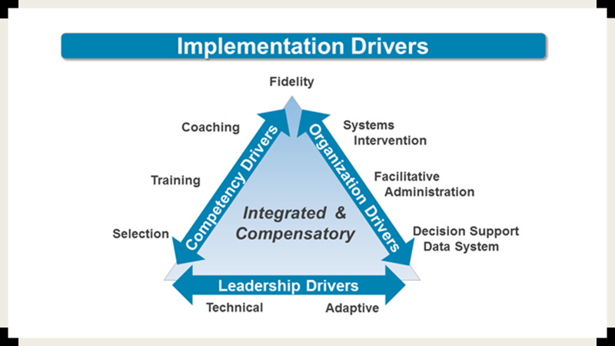
Notes:
Ngozi

Slide 36
WOW students started the year with mental health challenges; 2/3 of those at risk improved by the end of the year. SY23
Baseline rates based on 94 WOW students, from 2 schools, who completed a fall assessment
    67 of those students completed a post-test assessment
    Pre-post match rate: 71%
AT BASELINE:
95.7% had experienced one or more lifetime traumas
Average number of lifetime traumas = 4.7 (out of 15)
47.3% (of 94 students at baseline) reported suicide ideation/self-harm (“Thoughts that you would be better off dead or of hurting yourself in some way.”) WOW overall average is 26%
Notes:
Scales Used:
CATS (Child and Adolescent Trauma Screen) to measure (a) lifetime trauma exposure (from 0-15 lifetime traumatic events) and (b) PTSD Symptoms
PHQ-9A (9-item “Patient Health Questionnaire for Adolescents”) to assess Depression
One item asks how frequently in the last two weeks respondents were bothered by “Thoughts that you would be better off dead, or of hurting yourself in some way?“
SCARED (Screening for Childhood Anxiety Related Disorders): Social Anxiety and Generalized Anxiety subscales.
Reminder: because four schools only had post-tests; their data is not included here; only Ruskin’s and Smith Hale’s data is included here.

Slide 37
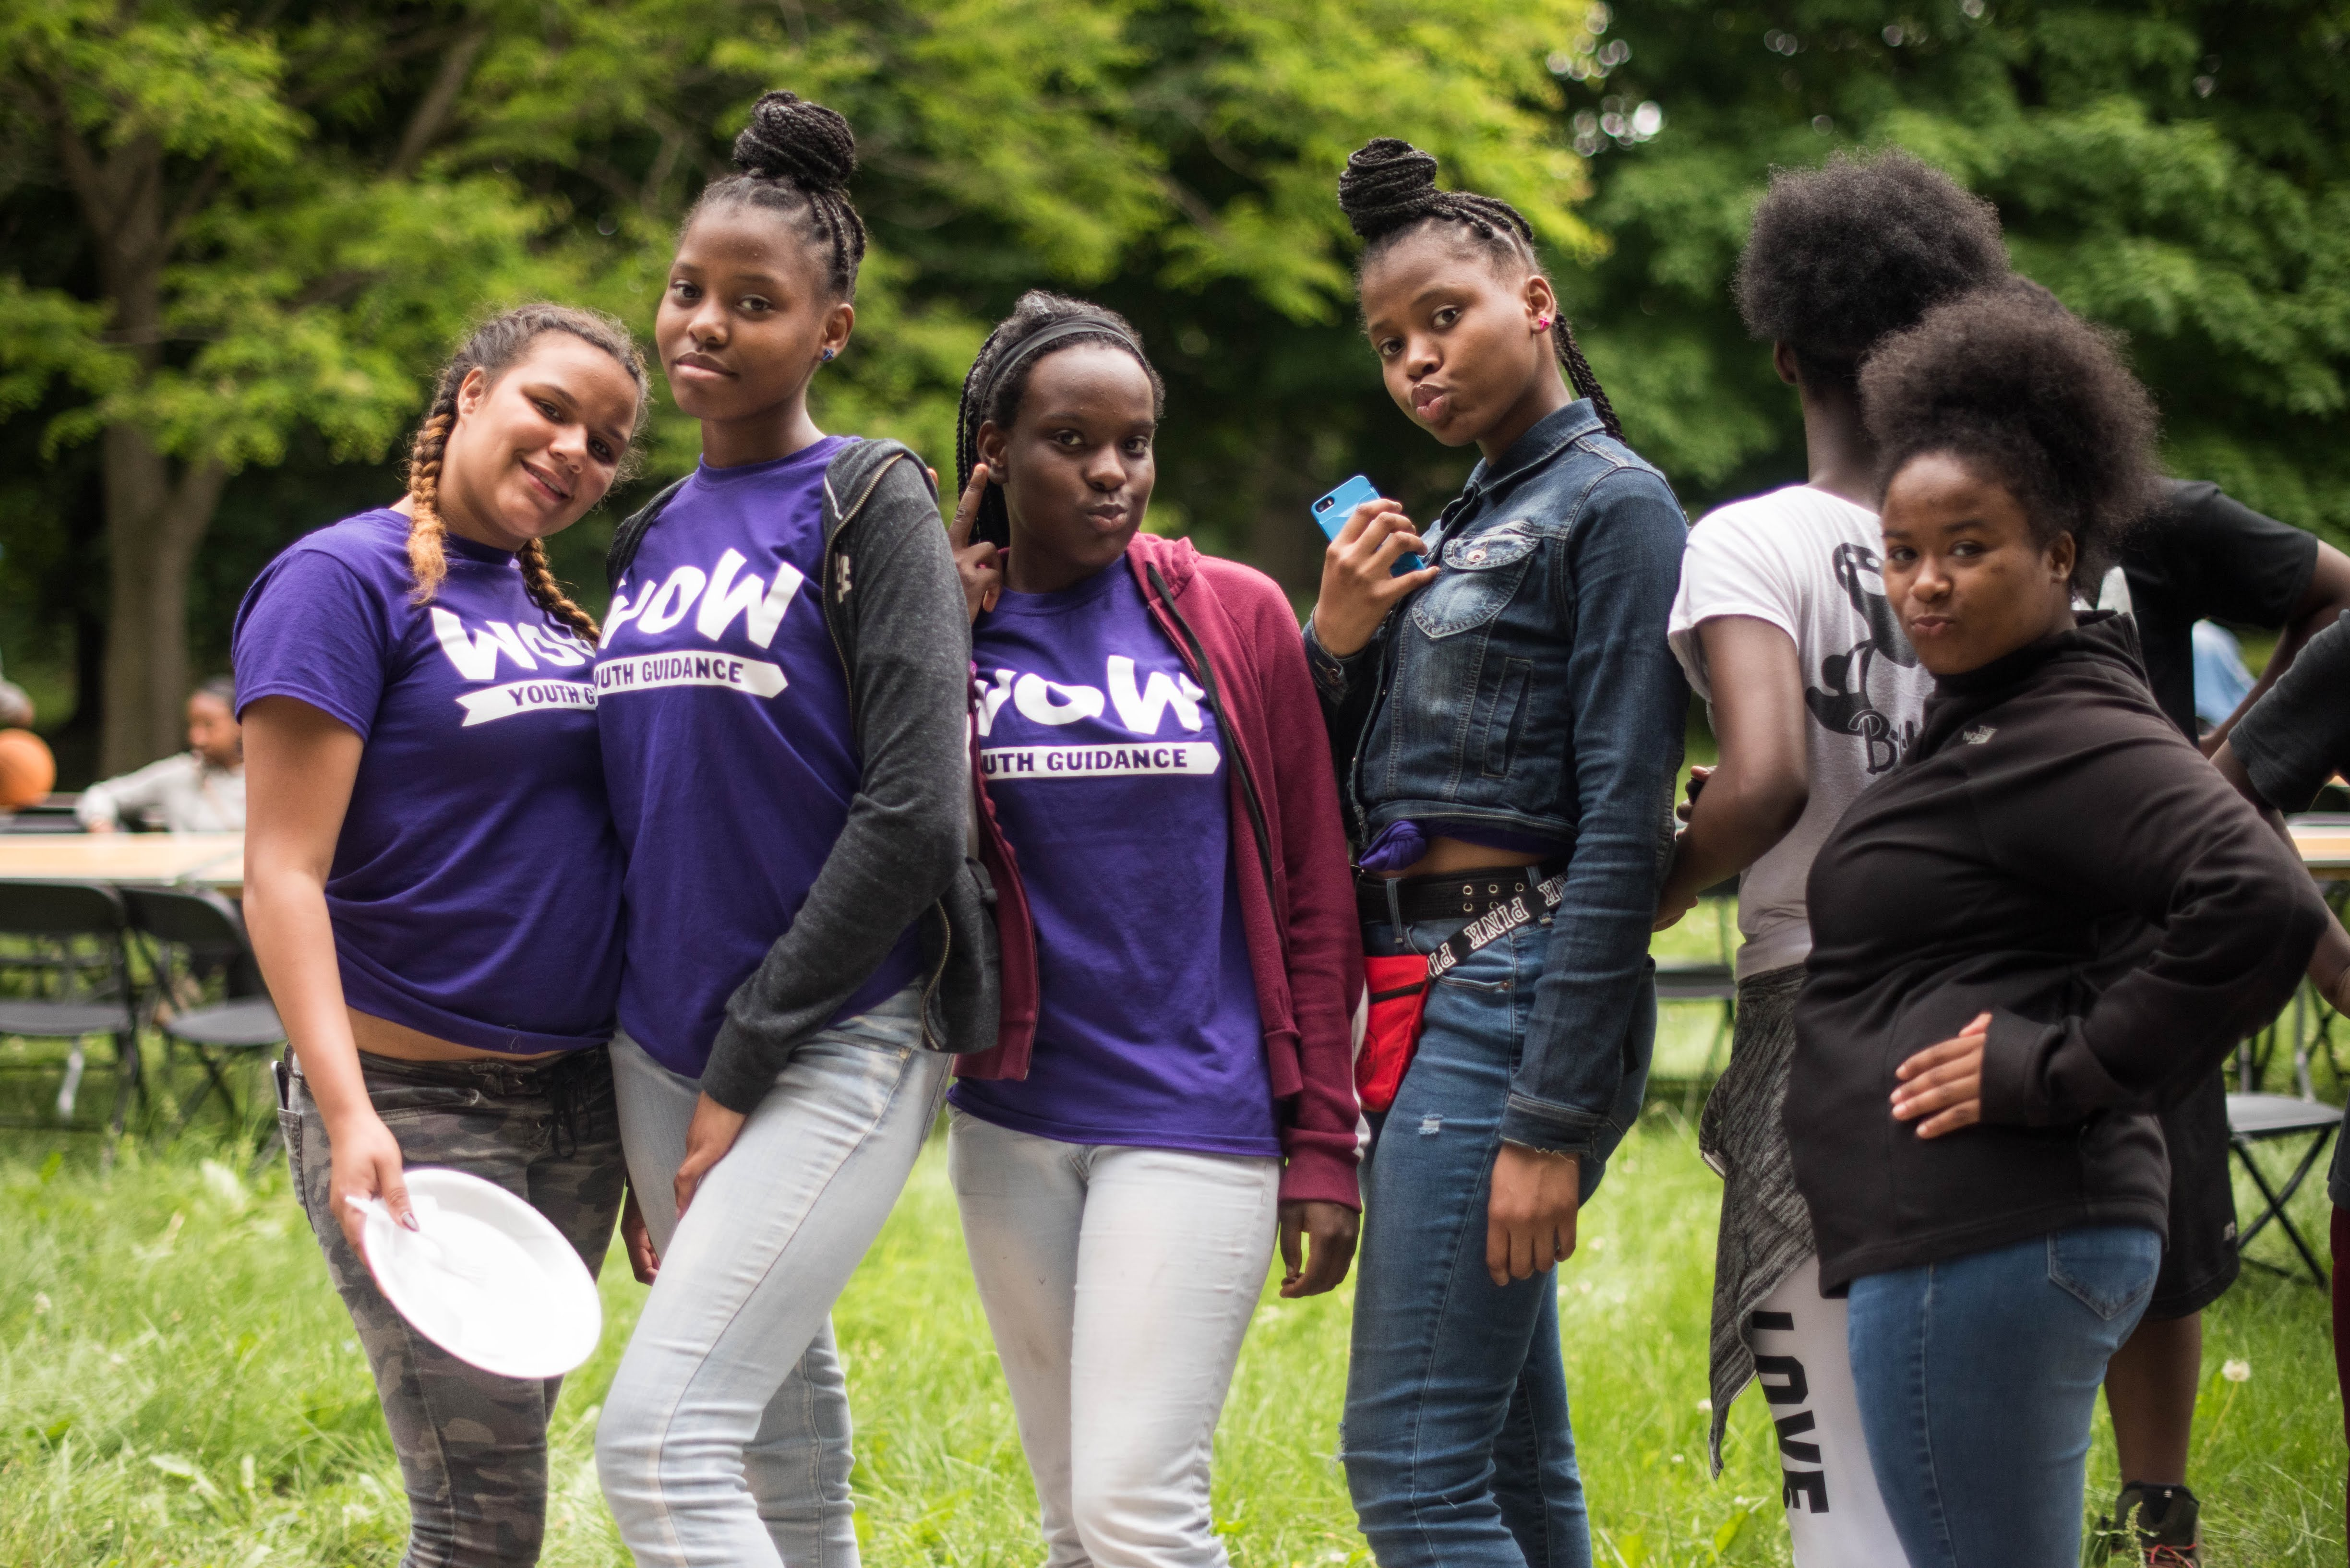

WOW is entering its 13th year of programing across the nation in 5 regions.
“I joined WOW to better myself. I joined to be a role model to my family.
I never would have guessed that I would have joined a circle of friends – a sisterhood – who would make us the best we can be.”
WOW Junior, 2018
We believe in the potential of every young woman.
Notes:
Gail

Slide 38
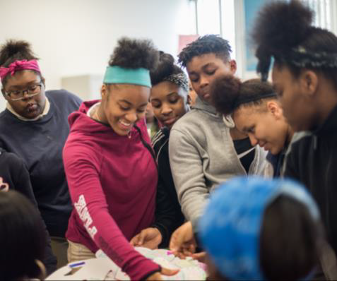
WOW | Replication
Youth Guidance looks to community stakeholders for input on local context
School District
Enabling Context for Implementation
  Demonstrated need for services
  Access to students during the school day
  Appropriate office and program space
  Collaborative Faculty and Staff
District Support
  Support for BAM & WOW during the school day
  Data sharing agreement
  Vision for school climate and discipline
  Agreement to provide funding allocation
  (ask of $1,830 per student)
Public and Philanthropic Sector Leadership
Formation of a local Advisory Council
  Public, philanthropic, and corporate leaders committed to building long-term sustainability
Public and private sector funding commitments to cover local implementation costs
18
Notes:
Michael

